Slide 1
SAP HANA 2.0 Installation

Slide 2
Post Installation of SAP HANA

Slide 3
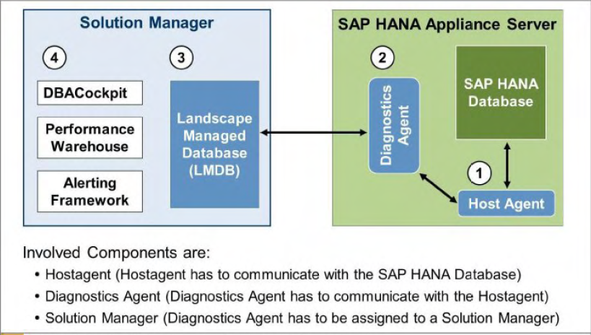
SAP Solution Manager Connectivity
SAP recommend establishing SAP Solution Manager connectivity and configuring a Remote Service Connection (via SAP Router) as part of initial setup.
As of Solution Manager 7.1 SP04. the SAP HANA databases can be integrated into SAP Solution Manager.
Performance Warehouse
Alerting Infrastructure
DBA Cockpit
Configure Remote Support via SAP Router to HANA DB Studio
For setting up Root Cause Analysis. System Monitoring, and EarlyWatch Alert for SAP HANA with Solution Manager Version 7.10. refer to SAP Note 1747682. The note has attachments.
Detailed instructions on how to set up are described in the attached documents within the note.

Slide 4
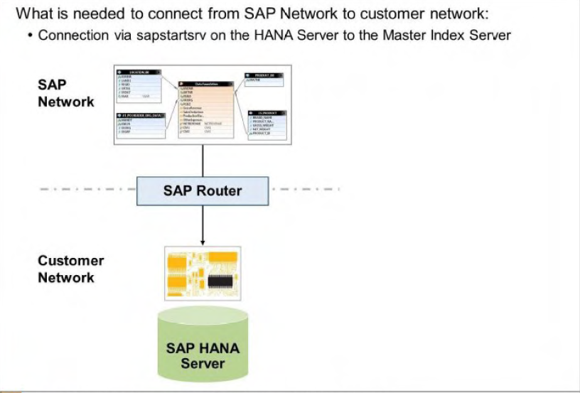
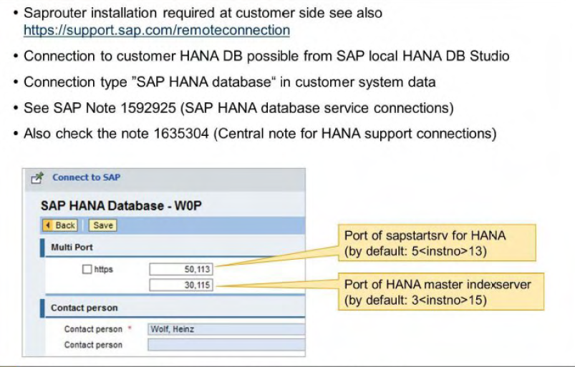

Slide 5
The General Licensing Process
As with all SAP products. you need to obtain a license from SAP in order to run SAP HANA.
For all tasks around the license management, you need the system privilege LICENSE ADMIN.
Generally, there are two kinds of license keys, as follows:
Temporary license keys
Temporary license keys are automatically installed by the SAP HANA system. This license is valid for 90 days. After 90 days, the license expires and the system is locked down. Once you have installed a valid permanent license. your system is usable until this license expires.
Permanent license keys
Permanent license keys are issued by SAP on request. Note that these licenses may also be limited with respect to time. At any time, you can install and reinstall a new permanent
license. If the current permanent license expires. a temporary license will be installed automatically. This temporary license following a permanent license is only valid for 28 days.
To request license key, access SAP Service Marketplace at https://support.sap.com/licensekey. This is a simple and safe way to request license key. You can also use SAP HANA studio.

Slide 6
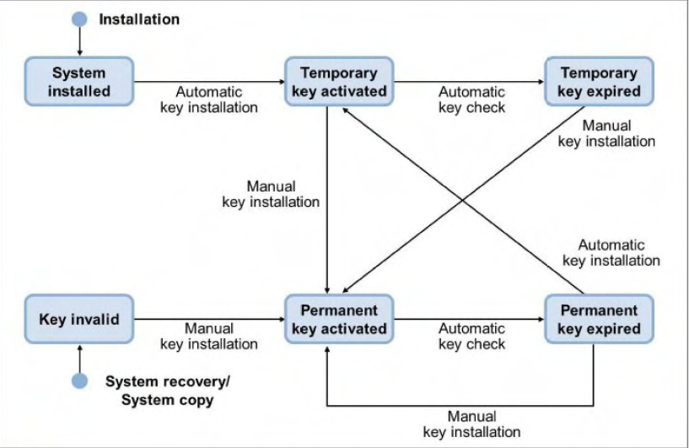
License Key
There are two types of permanent license key available for SAP HANA: unenforced and enforced.
If an unenforced license key is installed, the operation of SAP HANA is not affected if its
memory consumption exceeds the licensed amount of memory.
However. if an enforced license is installed. the system is locked down when the current
memory consumption of SAP HANA exceeds the licensed amount of memory plus some
tolerance. If this happens, either SAP HANA needs to be restarted, or a new license key that
covers the amount of memory in use needs to be installed.

Slide 7
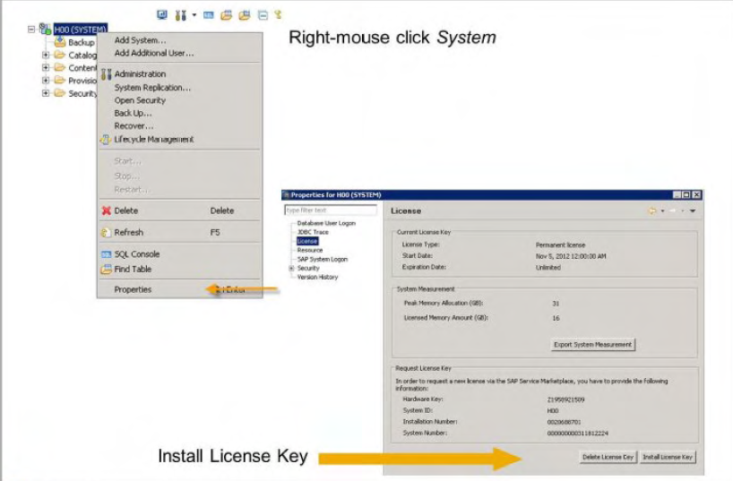
Apply License
Number 2147483647 is the virtual unlimited licensed memory that the temporary license provided after SAP HANA installation.
The licensed memory is the amount of memory that a customer wants to assign to a particular HANA instance. When a customer requests a license key from the SAP Service Marketplace. it asks the customer to provide such a number. The customer can decide how much they want to assign to the particular instance from the whole amount the customer bought. Then the specified number will be put into the generated license key file. Once the license key is installed into the designated HANA instance. the number will be set in the HANA instance and it shows in SAP HANA studio.
Memory allocation in HANA Database implements a pool concept. That is. memory is preallocated from the operating system to gain performance on actual allocations done in HANA DB code. By default. the Memory manager allocatesup to 90°/o of the available physical memory and it is shown as Peak memory usage in SAP HANA Studio.

